Slide 1
Welcome to CSE 142!
Miya Natsuhara
Spring 2021
Please make sure your microphone is muted.
If you’re willing, turn on your video so we can see you!

Slide 2
You Made It!

Slide 3
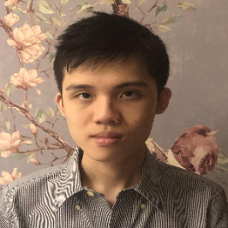
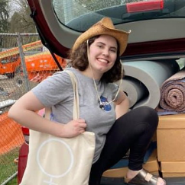
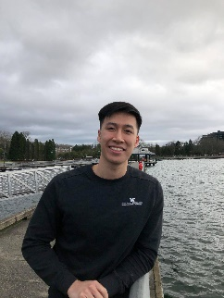
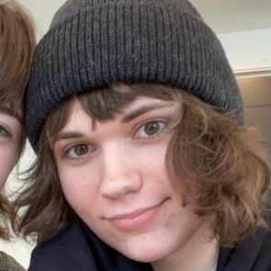
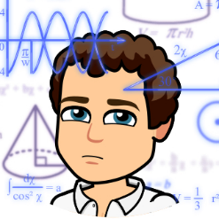
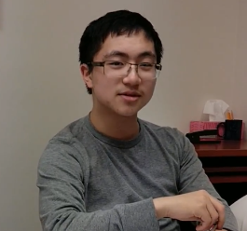
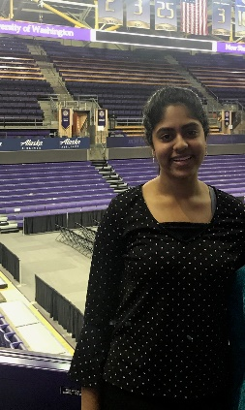
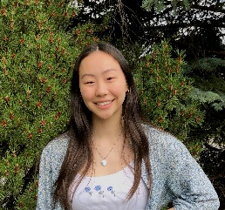
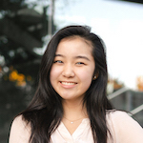
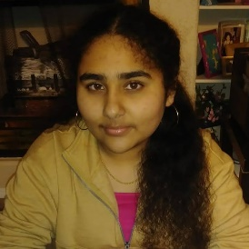
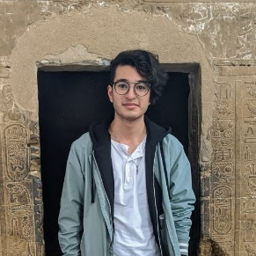
Thank your TAs!!
Notes:
UPDATE ME

Slide 4
Learning Objectives
or “What will did I learn in this class?”
Functionality/Behavior: Write functionally correct Java programs that meet a provided specification and/or solve a specified problem
Functional Decomposition: Break down problems into subproblems that are modular and reusable, and define methods to represent those subproblems
Control Structures: Select and apply control structures (e.g. methods, loops, conditionals) to manage the flow of control and information in programs
Data Abstraction: Select and apply basic data abstractions (e.g. variables, parameters, arrays, classes) to manage and manipulate data in programs
Code Quality: Define programs that are well-written, readable, maintainable, and conform to established standards

Slide 5
(Partial) Topic List
or another view on “What did I learn in this class?”
Methods
Parameters
Return Values
Variables
Types
Loops (for and while)
Conditionals
Console (User) I/O
File I/O
Arrays
Classes
Inheritance
ArrayList

Slide 6
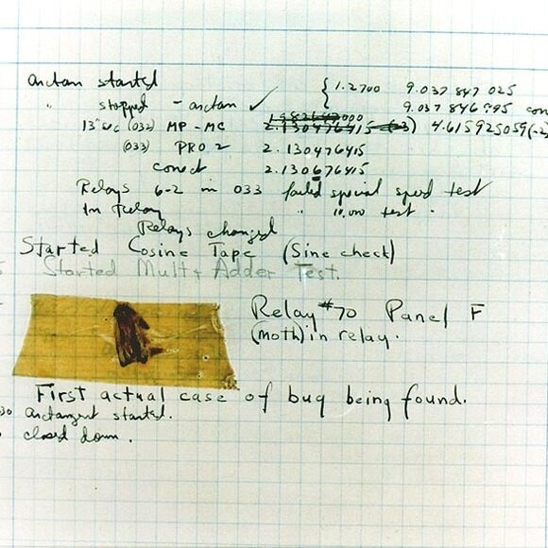
Underlying Skills
or “What did I learn in this class without realizing it?”
Computational thinking: breaking problems down into smaller, well-defined steps that can be recombined
“Thinking like a computer” (Also called algorithmic thinking)
Testing: determining whether or not a program works as expected
Requires really knowing what “as expected” means
Debugging: finding and fixing errors in existing code
Often just as hard (or harder!) than writing the code in the first place

Slide 7
Learning in CSE 142 (or anywhere)

Slide 8
Applications of CS
or “What can I do with what I learned?”
Detect and prevent toxicity online
Digitize basketball players
Help DHH people identify sounds
Figure out how to best distribute relief funds
Recognize disinformation online
Make movies
Improve digital collaboration
Fix Olympic badminton
And so much more!

Slide 9
Future Courses
or “What can I do next?”
Course | Overview
CSE 143 * + | Intermediate programming with data structures (Java)
CSE 154 * + | Introduction to web programming (several languages)
CSE 160 + | Introduction to programming for data analysis (Python)
CSE 163 * + | Intermediate programming for data analysis (Python)
CSE 180 | Introduction to data science (Python)
* Offered in Summer 2021
+ Offered in Autumn 2021
See also: https://www.cs.washington.edu/academics/ugrad/nonmajor-options/intro-courses

Slide 10
Frequently Asked Questions
How can I get better at programming?
Practice!
How can I learn to X?
Search online, read books, look at examples
What should I work on next?
Anything you can think of! (Here are some ideas)
Beware: it’s hard to tell what’s easy and what’s hard.
Should I learn another language? Which one?
That depends– what do you want to do?
What’s the best programming language?
😠 (take CSE 341)

Slide 11
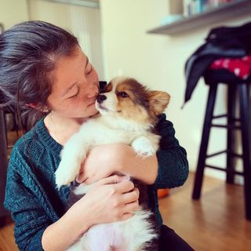
Thank you!!!

